Slide 1


Slide 2

Topics
Generalized Linear Regression
Family and Link function
Maximum Likelihood estimations vs OLS
Poisson Regression
Logit/Probit Models
Gamma Regression

Slide 3
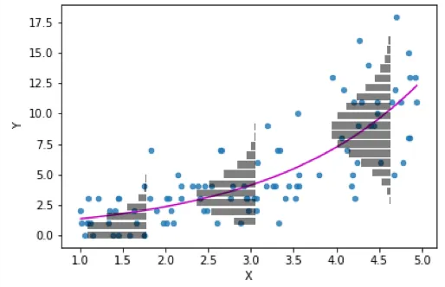
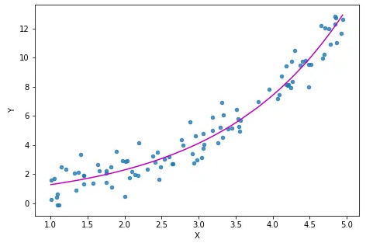
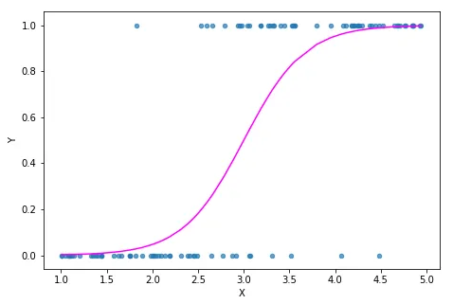
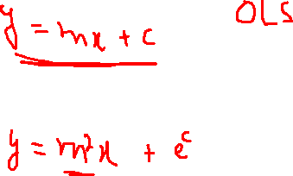
Generalized Linear Model
Generalized Linear Model object enables users a flexible generalization of linear regression to fit the response variables via a specialized Link Function.
Moreover, the model allows for dependent variables to have a non-normal distribution. Like all regressions, GLM is also a supervised ML model. ​
Notes:
https://towardsdatascience.com/generalized-linear-models-9cbf848bb8ab
Limitations in explaining the prediction as a linear combination of variables e.g., probabilities with Binomial distribution
Not all response variables follow normal distribution
It is often difficult to preserve linearity in parameters
Users might want to look at the likelihood of the occurrence of an event which can not be computed by fitting line of best fit

Slide 4

Family Parameter & Link Function
There are two components of GLM. ​
Family Parameter – specifies the Probability Distribution to generate the response variable Y.​
Link Function – forms a connection between a transformed response variable and the linear combination of independent variables.
Random Component – Explains distribution of dependent variable
Link Function – Establishes relationship between random and systematic components
Systematic Component – Explains dependent variable as a linear combination of independent variable
GLM Framework
Notes:
https://towardsdatascience.com/generalized-linear-models-9cbf848bb8ab

Slide 5
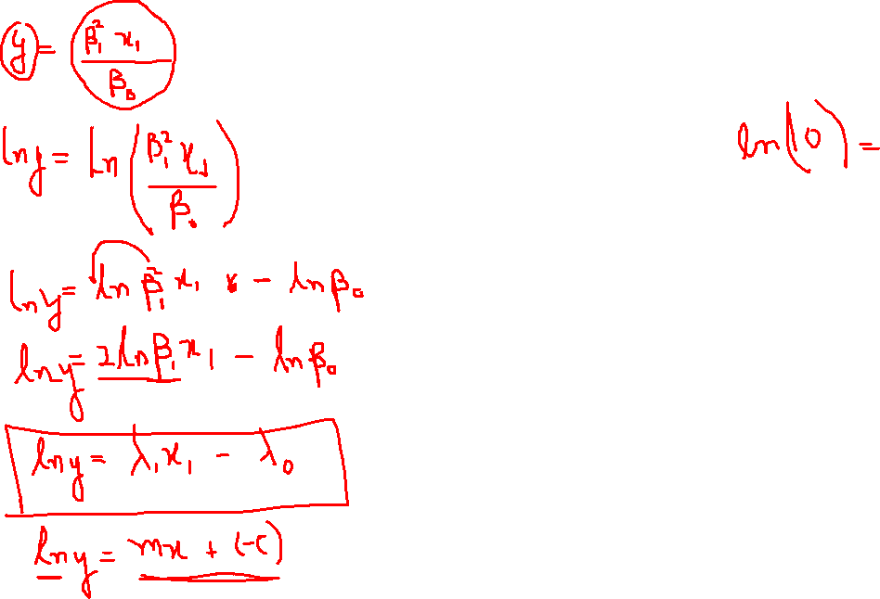

Slide 6

Common Family Parameters
Gaussian – Conditionally Normally distributed response with constant standard deviation – Linear Regression models we have fit so far.
Binomial – Dependent variable has binary outcomes (Success or Failure), and the model is called Logistic Regression.
Poisson - Dependent variable has count data (number of events in the fixed area and/or length of time), and the model is called Poisson Regression.
Gamma – Dependent variable has continuous data with skewed distribution and variation increases with the mean can be modeled with a Gamma distribution.
Negative Binomial – Dependent variable has count data with VAR(y) > E(Y)
Notes:
https://towardsdatascience.com/generalized-linear-models-9cbf848bb8ab

Slide 7

Common Link Functions
Identity – link (form used in normal and gamma regression models):
$$g\left(μ\right)= μ$$
Log – used when m cannot be negative as when data are Poisson counts
$$g\left(μ\right)=ln\left(μ\right)$$
Logit - used when m is bounded between 0 and 1 as when data are binary
$$g\left(μ\right)=ln(\frac{μ}{1 − μ})$$
Probit – Similar to a logit function
Inverse – used when m are positive real numbers
$$\left(μ\right)= 1/μ$$
Square root – used when m are positive with type exponential distributions
$$g\left(μ\right)= μ^{2}$$
Inverse Square root - used when m are positive with type exponential distributions
$$g\left(μ\right)=1/μ^{2}$$
Notes:
https://towardsdatascience.com/generalized-linear-models-9cbf848bb8ab

Slide 8
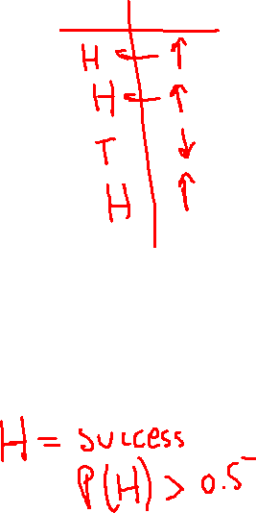
OLS (Ordinary Least Square) vs MLE (Maximum Likelihood Estimation)
OLS is a method for estimating the parameters of a linear regression model.
The method assumes that errors (the difference between the predicted and actual values) are normally distributed and have constant variance. OLS aims to find the parameters that minimize the sum of the squared errors.
MLE is a more general method that can be used to estimate the parameters of a wide range of statistical models.
The method assumes that the observed data come from a probability distribution that depends on some unknown parameters. MLE aims to find the values of the parameters that maximize the likelihood of observing the data that were observed.
Notes:
https://www.youtube.com/watch?v=XepXtl9YKwc&ab_channel=StatQuestwithJoshStarmer
Maximum likelihood estimation (MLE) and ordinary least squares (OLS) are both methods for estimating the parameters of a statistical model, but they are used in different contexts and have different assumptions.
OLS is a method for estimating the parameters of a linear regression model. The method assumes that the errors (the difference between the predicted values and the actual values) are normally distributed and have constant variance. OLS aims to find the parameters that minimize the sum of the squared errors. This method is widely used and has several attractive properties, such as simplicity and computational efficiency. However, OLS can be sensitive to outliers and violations of the underlying assumptions.
MLE is a more general method that can be used to estimate the parameters of a wide range of statistical models. The method assumes that the observed data come from a probability distribution that depends on some unknown parameters. MLE aims to find the values of the parameters that maximize the likelihood of observing the data that were actually observed. The likelihood function is a function of the parameters, and its shape depends on the assumed probability distribution. MLE is often used when the underlying distribution is not known, but a parametric form can be assumed.

Slide 9
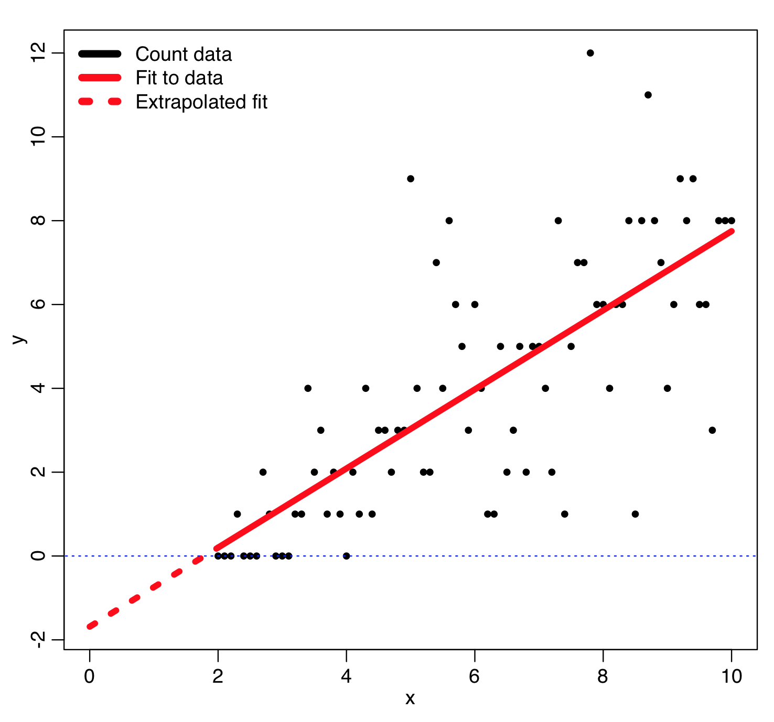
Poisson Regression
Poisson Regression (also called Count Regression) fits the model to data with a count response variable.
It is similar to regular multiple regression except that the dependent (Y) variable is an observed count that follows the Poisson Distribution.
In Generalized Linear Model object, a poisson regression is represented by Poisson family parameter.
Example:
The number of awards earned by students at one high school. Predictors of the number of awards earned include the type of program in which the student was enrolled (e.g., vocational, general, or academic) and the score on their final exam in math.
Notes:
Poisson Regression (also called Count Regression) fits model to a data with a count response variable. It is similar to regular multiple regression except that the dependent (Y) variable is an observed count that follows the Poisson distribution such as the number of students in a class or the number of items sold in a day. Thus, the possible values of Y are the nonnegative integers: 0, 1, 2, 3, and so on.
Why not just say positive integers
Example:
The number of people in line in front of you at the grocery store. Predictors may include the number of items currently offered at a special discounted price and whether a special event (e.g., a holiday, a big sporting event) is three or fewer days away.

Slide 10
Logit Models
Logistic Regression is the appropriate regression analysis to conduct when the dependent variable is dichotomous (binary). Like all regression analyses, the logistic regression is a predictive analysis involving probabilistic outcomes.
The logit model is based on the logistic function (also called the sigmoid function), which is used to model situations where there are two / binary possible outcomes or categorical outcomes.
In Generalized Linear Model object, logistic regression is represented by a Binomial family parameter and logit link function.

Slide 11
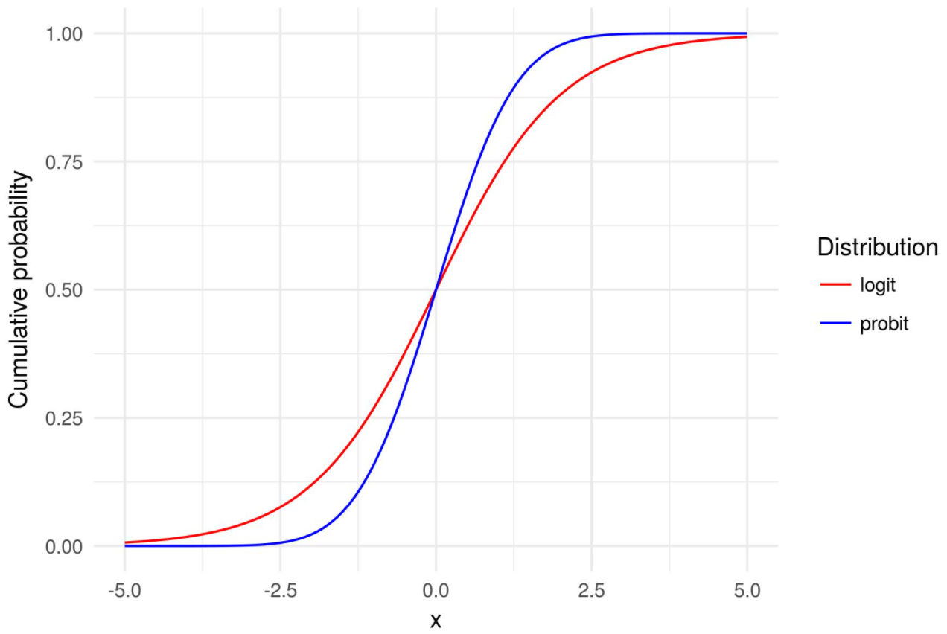
Probit Models
A Probit Model (also called Probit Regression), is a way to perform regression for binary outcome variables. Binary outcome variables are dependent variables with two possible outcomes, like yes/no and success/failure.
Probit models are like logit models, but they are based on the probit function instead of the logistic function. The Probit model determines the likelihood that an item or event will fall into one of a range of categories
In Generalized Linear Model object, a probit regression is represented by Binomial family parameter and probit link function.

Slide 12
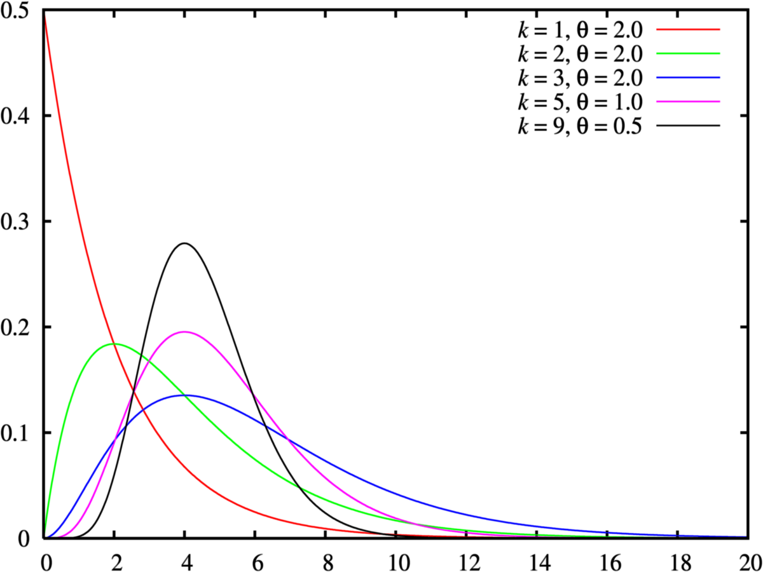
Gamma Regression
Gamma Regression fits the model to a data with a strictly positive response variable and rightly-skewed error distribution.
This regression is often used for survival analytics, such as waiting time, the time between failures, accident rate, risk analysis, and so forth.
In Generalized Linear Model object, a gamma regression is represented by the Gamma family parameter.

Slide 13

THANK YOU
Training and Certification

